Slide 1
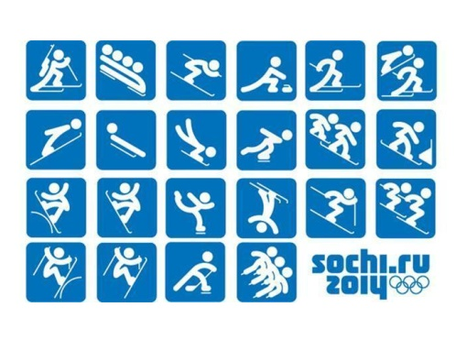

Slide 2
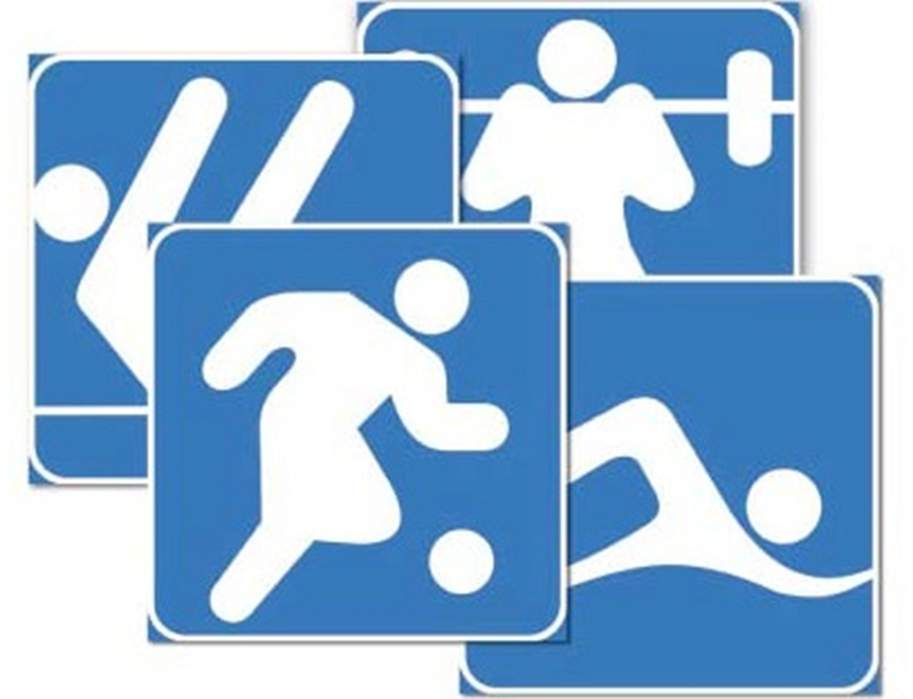
Different kinds of sport

Slide 3
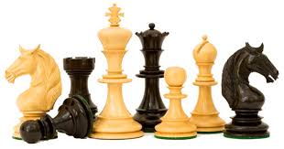
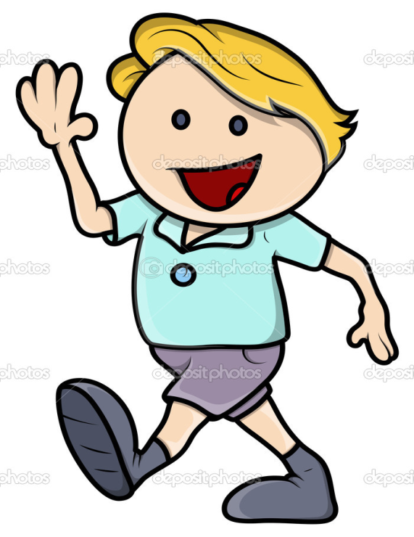
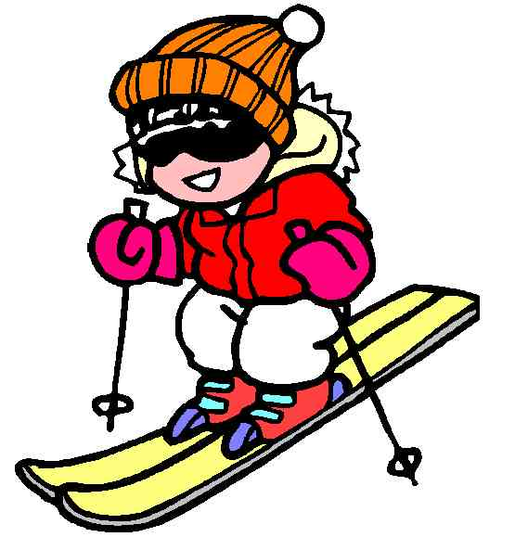

Slide 4
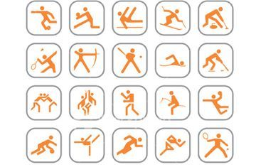
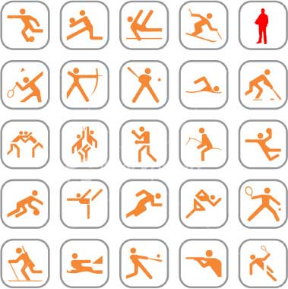
Sport and sports
Sport
sports

Slide 5
Make your self-assessment
The level of the task
Necessary | Advanced
I did everything
Myself | With some help
I did everything
Correctly | With mistakes
My mark is…

Slide 6
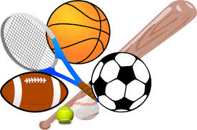
Find the odd word
Running, jumping, athletics, windsurfing, walking, cross-country running.
Football, basketball, gymnastics, rugby, baseball, handball.
Water skiing, surfing, windsurfing, diving, horse riding, water polo.

Slide 7
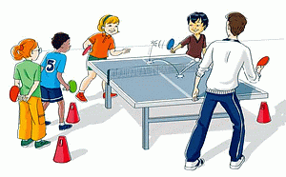
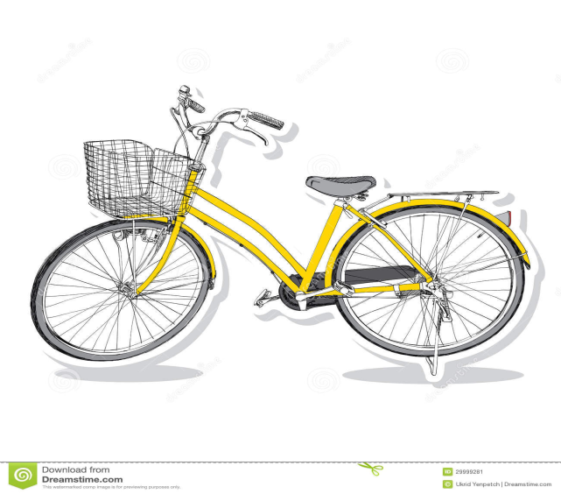
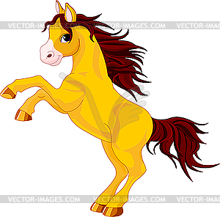
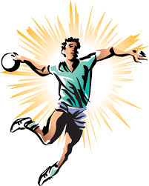
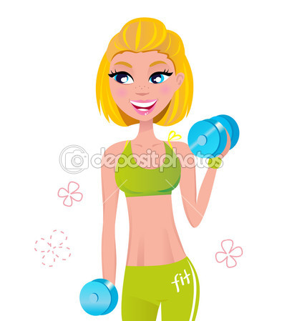
What we will read about?

Slide 8
Ex.4 p.100-101 Слова-помощники
Is used-используется
Team-команда
Are not allowed-не разрешено
To handle-брать руками
To keep fit-поддерживать форму
Travel-путешествовать
A lot of places-множество мест
Favourite hobby- любимое занятие

Slide 9
Ex.4 p.100-101 Слова-помощники
With women-среди женщин
Follow classes-смотреть уроки
In the gym-в спортивном зале
A net-сетка
Small bats- маленькие ракетки

Slide 10
Ex.4 p.100-101 Слова-помощники
Cheapest-самый дешевый
Healthy-здоровый
Get up-просыпаться, вставать
Travel-путешествовать
The countryside-окрестности, местность
King-король
Watch-смотреть
Try to win some money-пытаются выиграть деньги

Slide 11
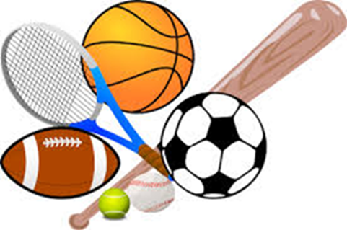
True or False?
Three teams of 15 players play handball.
Aerobics is popular with women.
You can play tennis only in the gym.
Walking is a very expensive form of sport.
Horse riding is called the sport of strong people.

